Slide 1









Quality Assurance and Management

Slide 2
Outlines
▪
▪
▪
▪
Quality Concepts and Software Quality Assurance
Software Reviews (Formal
Software Reliability
The Quality Standards
Technical
Reviews)
•
•
•
•
ISO 9000
CMM
Six Sigma for SE SQA Plan

Slide 3

What is Quality
Quality – developed product meets it’s specification
Quality Management
Ensuring that required level of product quality is achieved
•
•
•
•
Defining procedures and standards
Applying procedures and standards to the product and process
Checking that procedure
are followed
Collecting and analyzing various quality data

Slide 4

Software Quality Assurance (SQA)
▪
Software quality assurance (also called quality management) is
an
umbrella activity
that
is applied throughout
the
software
process
It is planned and systematic pattern of activities provide high degree of confidence in the quality
Software quality assurance (SQA) encompasses
▪
necessary
to
▪
•
An SQA process
•
•
•
•
Specific quality assurance and quality control tasks
Effective software engineering practice
Control of all software work products
A procedure to ensure compliance with software
standards
Measurement and reporting mechanisms
development
•

Slide 5

SQA Activities
▪
▪
Prepare an SQA plan for a project
Participate in the development of the project’s software process
description
Review software engineering activities to verify compliance with the defined software process
Audit designated software work products to verify compliance
▪
▪
with those defined as part
of the software process
▪
Ensure that deviations in
documented and handled
software work and work products are
according to a documented procedure
▪
Records any noncompliance and reporting to senior management

Slide 6

SQA Techniques
▪
Statistical quality assurance implies the following steps:
1.
2.
Information about software defects is collected and categorized
An attempt is made to trace each defect to its underlying cause
Ex., non-conformance to specifications, design error, violation of standards, poor communication with the customer
o
3.
Using the Pareto principle (80 percent of the defects
can be
traced
to
20
percent
of all
possible
causes),
isolate
the
20
percent (the "vital few").
Once the vital few causes have been identified, move to the problems that have caused the defects.
4.
correct
▪
Some
of
the
defects
are
uncovered as software
is
being
developed.
Other are encountered after the software has been released.
▪

Slide 7

SQA Techniques (Cont.)
Uncovered errors can be tracked to (one or more) of the following causes
•
•
•
•
•
Incomplete or erroneous specifications (IES)
Misinterpretation of customer communication (MCC) Intentional deviation from specifications (IDS) Violation of programming standards (VPS)
Error in data representation (EDR)
•
•
•
•
•
•
•
Inconsistent component interface (ICI)
Error in design logic (EDL)
Incomplete or erroneous testing (IET) Inaccurate or incomplete documentation (IID)
Error in programming language translation of design (PLT) Ambiguous or inconsistent human/computer interface (HCI) Miscellaneous (MIS)

Slide 8

Software Reviews (Formal Technical Reviews)
▪
A
formal
technical
review
(FTR)
is
a
software
quality
control
activity performed by software engineers (and others)
The objectives of an FTR are:
▪
1.
To uncover errors in function, logic, or implementation; for any
representation of the software
To verify that the software under review meets its requirements
To ensure that the software has been represented according to
2.
3.
predefined standards
To achieve software that is developed in a uniform manner
To make projects more manageable
4.
5.

Slide 9

Review Reporting &
Record Keeping
▪
During the FTR,
•
a reviewer (the recorder) actively records all issues that have
been raised
▪
These are summarized at the end of the review meeting, and a
reviewed issues list is produced
▪
In
addition,
a
formal
technical
review
summary
report
is
completed

Slide 10
Review Guidelines
Guidelines for conducting formal technical reviews must be
established in advance, distributed to all reviewers, agreed upon & then followed
Review the product, not the producer
Set an agenda and maintain it
Limit debate and denial
Speak problem areas, but don't attempt to solve every problem noted
Take written notes
Conduct meaningful training for all reviewers
Limit the number of participants and insist upon advance preparation
Develop a checklist for each product that is likely to be reviewed
Allocate resources and schedule time for FTRs
Review your early reviews

Slide 11

Differentiation of SQA & SQC
Differentiation Software Quality Assurance (SQA) - Software Quality Control (SQC)
Criteria
SQA
SQC
Definition
SQA is a set of activities for ensuring quality in software engineering processes (that ultimately result in quality in software products). The activities establish and evaluate the processes that produce products
SQC is a set of activities for
products. The activities focus on identifying defects in the actual products produced
ensuring quality in software
Focus
Process focused
Product focused
Orientation
Prevention oriented
Detection oriented
Breadth
Organization wide
Product/project specific
Scope
Relates to all products that will ever be
created by a process
Relates to specific product
Activities
Process Definition and
Implementation, Audits, Training
Reviews, Testing

Slide 12
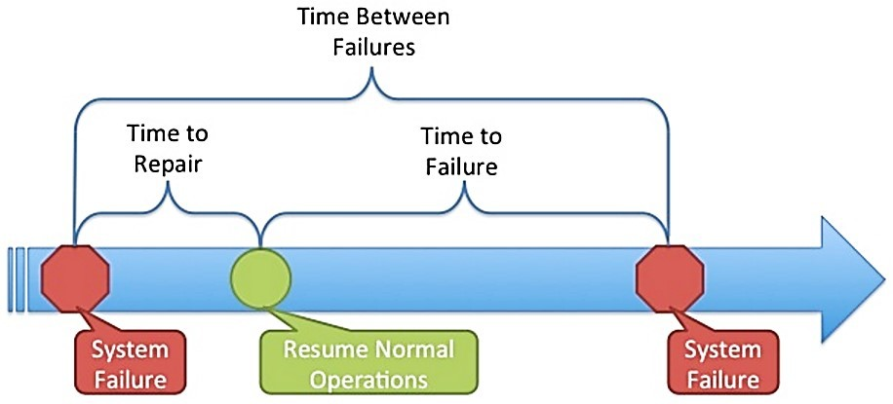

Software Reliability
Software reliability is defined in statistical terms as
The probability of failure-free operation of a computer program
in a specified environment for a specified time
A simple measure of reliability is meantime-between-failure (MTBF):
MTTF = mean-time-to-failure
MTTR = mean-time-to-repair
MTTR = Total hours of maintenance ÷ # of repairs
MTBF = # of operational hours ÷ # of failures
MTTF = Total hours of operation ÷ Total assets in use

Slide 13
Measures of Reliability
▪
Many researchers argue that MTBF is a far more useful measure
than other quality-related software metrics
An end user is concerned with failures, not with the total defect count
Because each defect contained within a program does not have
▪
▪
the
same
failure
rate,
the
total
defect
count
provides little
indication of the reliability of a system
▪
An alternative measure of reliability is failures-in-time (FIT)
•
a statistical measure of how many failures a component will have
over one billion hours of operation

Slide 14

Software Safety
▪
Software safety is a software quality assurance activity
•
that focuses on the identification and assessment of potential
hazards that may affect software negatively and cause an entire
system to fail
hazards can be identified early in the software process,
▪
If
•
software design
features
can
be specified that will
either
eliminate or control potential hazards
▪
A
modelling and analysis process is conducted as part of software
safety
Initially, hazards are identified and categorized by criticality and risk
▪

Slide 15

Software Safety Cont.
▪
Although
software
reliability
and
software
safety
are
closely
related to one another, it is important to understand the subtle
difference between them
•
Software
reliability
uses statistical analysis
to
determine
the
likelihood that a software failure will occur
However, the occurrence of a failure does not necessarily result
in a hazard or accident
Software safety examines the ways in which failures can lead to an accident
•
•

Slide 16


The quality standards
ISO 9000 and 9001, Six Sigma, CMM

Slide 17
ISO 9001
▪
In
order
to
bring
quality
in product
and
service,
many
organizations are adopting Quality Assurance System
▪
ISO standards are issued by the International
Standardization (ISO) in Switzerland
Organization for
▪
Proper documentation
is
an
important
part
of
an
ISO
9001
Quality Management System.
▪
ISO
is
the
quality assurance
standard
that
applies
to
9001
software engineering
It includes, requirements that must be present for an effective quality assurance system
ISO 9001 standard is applicable to all engineering discipline
▪
▪

Slide 18
ISO 9001 Cont.
The requirements described by ISO 9001:2000
address topics such
as
Management Responsibility
Design Control
Product Identification
Inspection
Quality System
Document
Traceability
Testing
Contract Review
Data Control
Process Control
Preventive Action
Control of Quality Records
Training
Internal Quality
Servicing
Audits
In order for a software organization to become registered to ISO 9001:2000
1. It must establish policies and procedures to address each of the
requirements just noted
2. Able to demonstrate that these policies and procedures are being followed

Slide 19

Six Sigma
▪
Six sigma is “A generic quantitative approach to improvement
that applies to any process”
Six Sigma is a disciplined, data-driven approach and methodology for eliminating defects in any process - from manufacturing to transactional and from product to service
▪
▪
To achieve six sigma, a process must not produce more
defects per million opportunities
than
3.4
•
•
4 Sigma → 6210 defects per million opportunities
5 Sigma → 230 defects per million opportunities
▪
Six sigma have two methodologies.
•
•
DMAIC (Define, Measure, Analyze, Improve, Control)
DMADV (Define, Measure, Analyze, Design, Verify)

Slide 20

DMAIC
- Six Sigma
Define:
Define
the
problem
or
process
to
improve
upon
related
to
the
customer and goals
Measure: How can you measure this process in a systematic way?
Analyze: Analyze the process or problem and identify the way in which it
be improved. What are the root causes of problems within the process?
can
Improve: Once you know the causes of the problems, present solutions for
them and implement them.
Control:
Utilize
Statistical
Process
Control
to
continuously
measure
your
results and ensure you are improving
Several Software Packages available to assist in measuring
yield, defects per million opportunities, etc.

Slide 21

DMADV
- Six Sigma
Define, Measure and analyze are similar to above method
Design: Avoid root causes of defects and meet the customer requirements
Verify: To verify the process, compare the process with the standard plan and
find differences

Slide 22
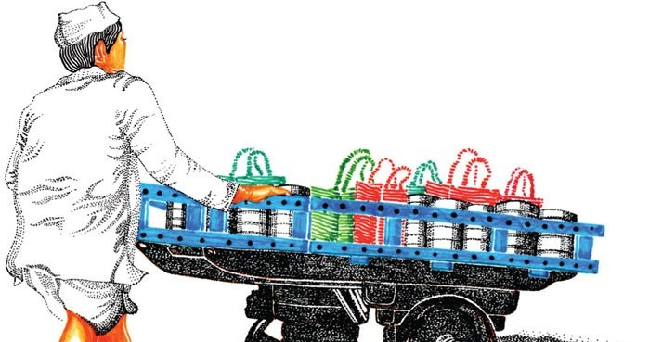


Example
of
Six
Sigma
Company
Mumbai's
Dabbawalas
For over 100 years they have delivered food to every part of the
city, earning them a Six Sigma rating (a Forbes rating of 99.9 % which
means one error in 6 million transactions).

Slide 23

CMM (Capability Maturity Model)
▪
To determine an organization’s current state of process maturity,
the SEI (Software Engineering Institute) uses an assessment that
results in a five point grading scheme
▪
The
grading
scheme
determines
compliance
with a
capability
maturity model (CMM) that defines key activities required at
different levels of process maturity
The SEI approach establishes five process maturity levels that are
defined in the following manner
Level 1: Initial
•
•
The software process is characterized as ad hoc and occasionally
Few processes are defined and success depends on individual effort

Slide 24

CMM (Capability Maturity Model)
Level 2: Repeatable
•
Basic
project management
processes
are
established
to
track
cost,
schedule, and functionality.
The necessary process discipline is in place to repeat earlier successes on
Project
•
Level 3: Defined
•
The software process for both management and engineering activities is
documented, standardized and integrated
This level includes all characteristics defined for level 2
•
Level 4: Managed
•
Detailed
collected
measures
of
the
software
process and product
quality
are
•
This level includes all characteristics defined for level 3

Slide 25
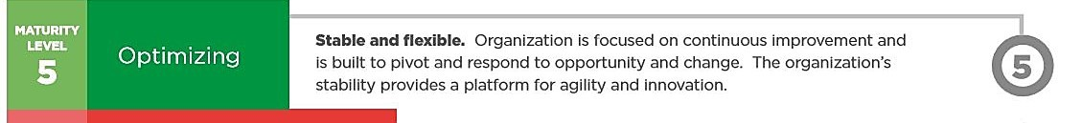
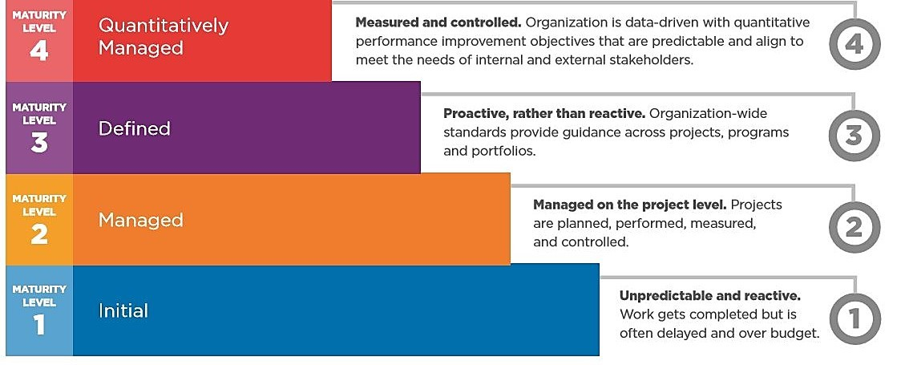

CMM (Capability Maturity Model)
Level 5: Optimizing
•
Continuous process improvement is enabled by quantitative feedback from
the process and from testing innovative ideas and technologies
This level includes all characteristics defined for level 4
•

Slide 26

SQA Plan
▪
The
SQA
Plan
provides
a
road map
for
establishing
software
quality assurance
The plan serves as a template for SQA activities that are instituted for each software project
The standard recommends a structure that identifies:
▪
▪
•
•
The purpose and scope of the plan
A description of all software engineering work products (e.g., models, documents, source code).
All applicable standards that are applied during the software process
•
•
SQA
actions and
their
placement
throughout
the
software
process
The tools and methods that support SQA actions and tasks
•

Slide 27

SQA Plan Cont.
•
•
Software configuration management procedures
Methods for assembling, safeguarding and maintaining all SQA- related records
•
Organizational
quality
roles
and
responsibilities
relative
to
product

Slide 28

Summary
▪
▪
▪
▪
▪
▪
▪
▪
SQA
Importance of SQA
SQA Activities
SQA Techniques
Software
Software
Software
Reviews (Formal
Reliability
Safety
Technical
Reviews)
The Quality Standards
•
•
•
ISO 9000
CMM
Six Sigma for SE
▪
SQA Plan

